Slide 1
CNEC Time Signatures in Well Logging with a pulsed D-T neutron generator
Long Vo

Slide 2
Agenda
Facilities
Data Acquisition scheme
List Mode Concept
Time Signature Derivation
Isotope-specific Time Signature: Hydrogen
Correlation to Hydrogen Index
Conclusion

Slide 3
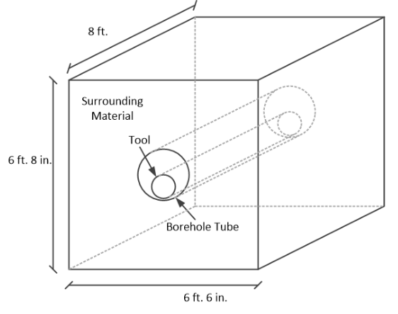
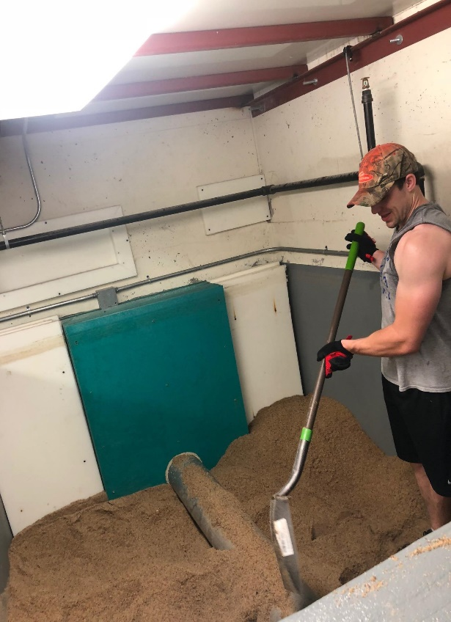
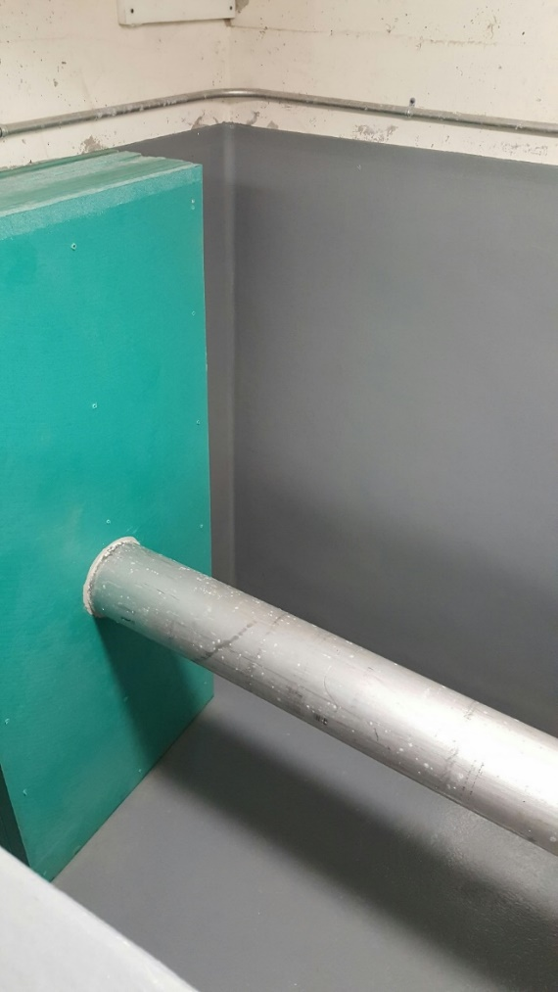
Tool and Test Chamber
65.37’’
47.09’’
34.58’’
17.27’’
NaI(Tl)
Helium-3
NaI(Tl)
BF3
Target
2’’ Lead

Slide 4
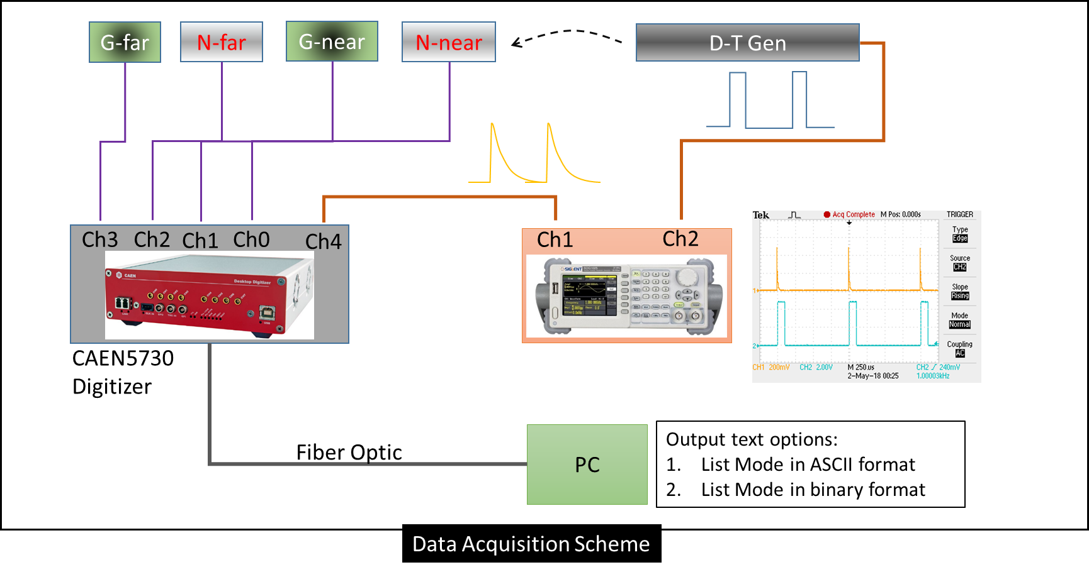
Data Acquisition Scheme at KSUMI facilities
The D-T Pulsed Neutron Generator is rated at 1kHz and 10% Duty Cycle
Neutron-induced events are detected by sensors and recorded by the digitizer.
Events’ ENERGY and TIME of detection are recorded.
Sensors and D-T generator are inside the simulated borehole, 2500 gallon volume of selected materials

Slide 5
List Mode Concept
The digitizer outputs (1) trigger list and (4) sensor response lists for every sample.
Below is an example of a trigger (Time) list and a photon sensor response (Time and Energy) list. Each row is an event.
Trigger time (µs) | Event’s detection time (µs) | Event’s Energy (MeV)
0 | 50 | 2.1
 | 221 | 5.9
 | 670 | 8.9
 | 990 | 1.1
1,000 | 1,023 | 3.5
 | 1,355 | 4.6
 | 1,702 | 2.7
2,000 | 2,073 | 1.5
 | 2,205 | 0.5
 | 2,890 | 5.1
0 second
3300 second
Energy spectrum (Counts vs. Energy) is constructed from this column
Time-Dependence (Counts vs. Pulse Duration) plot is constructed from these columns

Slide 6
Time Signature Derivation
Below is a Time-dependent plot of the Near NaI(Tl) photon sensor in 100% Water Sample
Plot exhibit events from 3,300,000 pulses vs. time after pulse initiated
This time-dependent plot contains the bulk of events ( signatures from many isotopes ) from the irradiated water sample.
Objective: Isolate events of interest such as Hydrogen prompt-capture signatures
Neutron Production Region
No Neutron Production
Or Die-away Region

Slide 7
Time Signatures Derivation
The time domain is now split into 100 bins of 10µs each
Each bin contains events that arrive during that time bin and these events are plotted into counts vs. energy
Hydrogen
For example, the events bounded by 90 and 100µs marks are plotted into counts vs. energy

Slide 8
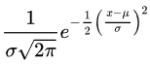
Isotope-specific Time Signatures: Hydrogen
Fit Hydrogen Prompt-capture peak with Gaussian and Quadratic functions to extract net-peak counts
Hydrogen

Slide 9
Isotope-specific Time Signatures: Hydrogen
The Hydrogen net-peak counts for all the time bins are calculated and plotted against their respective time bin.
For the Near NaI(Tl) Photon sensor in 100% water sample, the Hydrogen time-dependence plot is below:
Total:
178,670 counts

Slide 10
Signatures Extraction
From the Hydrogen time-dependence plot, information about the formation can be extracted:
In the neutron production region (0-100µs), the signatures are :
total counts
peak counts at 100µs
rising slope
In the die-away region (100-1000µs), the signatures are:
total counts
decay slope
For example, the decay slope in the die away region will be calculated and compare to the Hydrogen Index in all samples

Slide 11
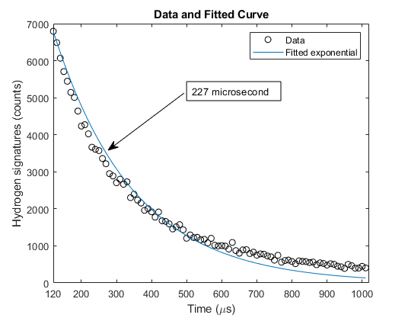
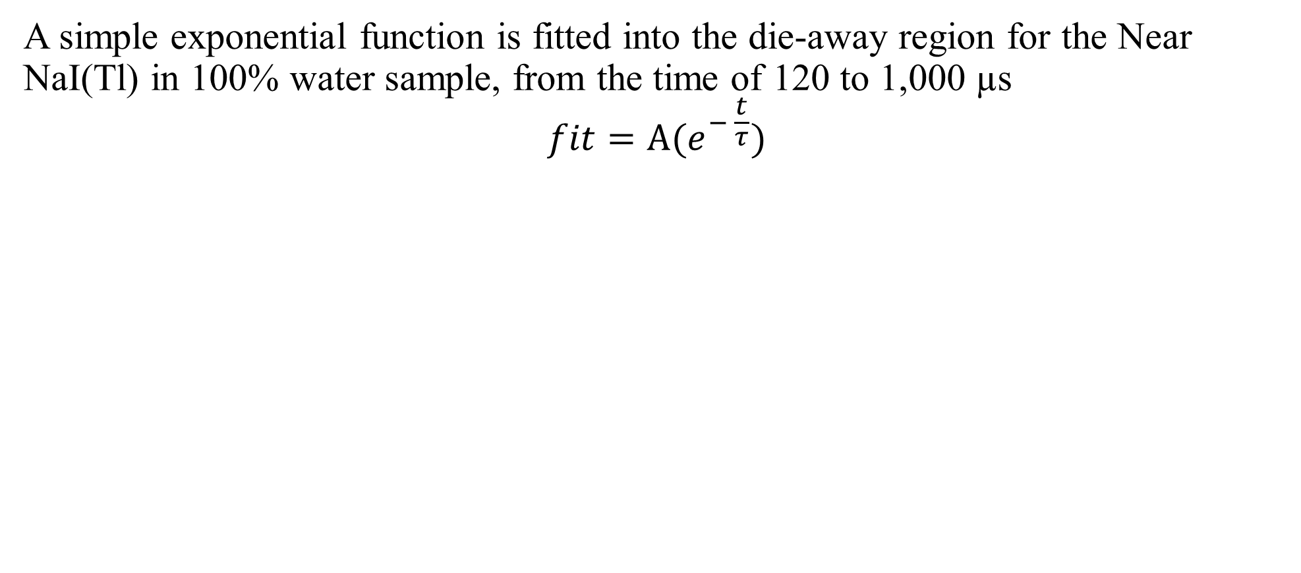
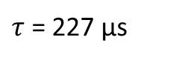
Decay slope in the die-away region
A simple exponential function is fitted into the die-away region for the Near NaI(Tl) in 100% water sample, from the time of 120 to 1,000 µs
$$fit=A(e^{− \frac{t}{τ}})$$
$τ$ = 227 µs

Slide 12

Decay (µs) vs. Hydrogen Index (Porosity %)
Porosity (%) | Rocks | Uniformity (yes or no) | Decay (µs)
0 | Sand | Yes | 985
 |  |  | 1143
>1 | Limestone** | Yes | 505
15 | Sand | No | 463
30 | Sand | Yes | 369
63 | Limestone | Yes | 328
100 (water) | none | Yes | 229
 |  |  | 227
 |  |  | 226
100 (saline) | Salt at 3.6%wt | Yes | 152
**Note: The >1%-porosity limestone sample started at 0%. When limestone was loading into the test chamber, light sprinkles from weather increased the porosity to an unknown level.
The fit predicts ~2% porosity.

Slide 13
Conclusion
Time-dependent signatures are promising indicators of formation’s Hydrogen Index ( or Porosity %) – even for non-uniform formation.
Hydrogen time signatures alone are not perfect indicators of Hydrogen Index because of other formation’s characteristics: density and absorbers presence.
Assessing other isotopic time signatures e.g. Oxygen, Carbon, and Sodium may give more information regarding formation’s characteristics.
Up to this point, only one sensor was analyzed for time signatures: the Near NaI(Tl) photon sensor. There are three other sensors available: Far NaI(Tl) photon sensor, Near BF₃ neutron sensor, and Far ³He neutron sensor.
Combining time signatures from all sensors may yield critical information about wells, thus supporting non-proliferation missions.

Slide 14
